Slide 1
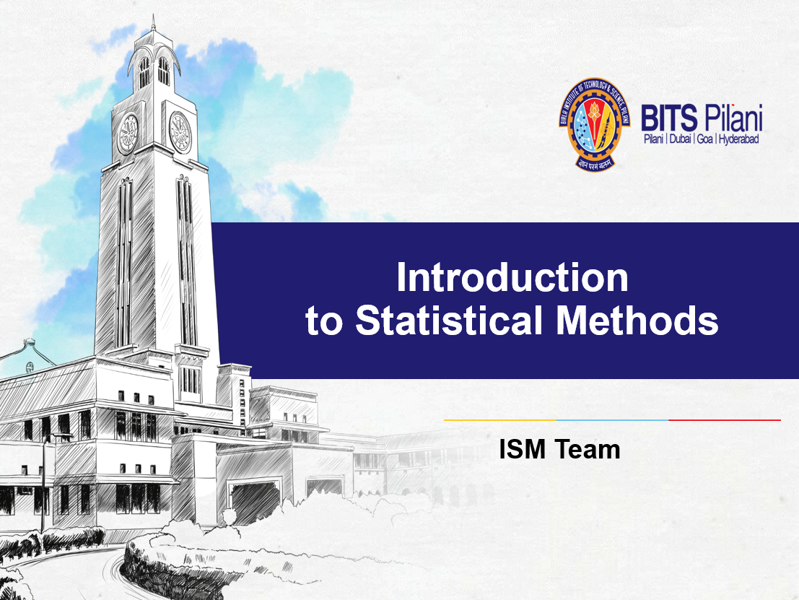

Slide 2


Slide 3
Contact Session 7: Module 4: Hypothesis Testing
Contact Session | List of Topic Title | Reference
CS - 7 | Sampling – random sampling and Stratified sampling, Sampling distribution – Central Limit theorem, Estimation– Interval Estimation, Confidence level | T1 & T2

Slide 4
Sampling: Terminology
POPULATION (Big data or Huge or Massive data)
A population is the set of all elements of interest in a particular study. The process of conducting a survey to collect data for the entire population is called a census.
SAMPLE (Small data)
A sample is a subset of the population. The process of conducting a survey to collect data for a sample is called a sample survey.
As one of its major contributions, statistics uses data from a sample to make estimates and test hypotheses about the characteristics of a population in the point of view of cost constraint. This part of statistics is called inferential statistics.

Slide 5
Terminology
Parameter
The various statistical characteristics or constants of a population such as Population mean, Population SD, Population Proportion etc., are called parameters.
Statistic
The various statistical functions of a sample such as sample mean, sample sd, sample proportion etc., are called statistics.
A statistic is a function of sample observations and is used to estimate its corresponding parameter. It is also known as estimator and its calculated value is called estimate.
A statistic is a variable and becomes a random variable if the sample is random sample.

Slide 6
Sampling
Sampling is a method or process of selecting samples from populations.
Data are gathered from samples and conclusions are drawn about the population as a part of the inferential statistics process
A sample provides a reasonable means for gathering useful decision-making information that might be otherwise unattainable and unaffordable.

Slide 7
Reasons for Sampling
Taking a sample instead of conducting a census offers several advantages
The sample can save money.
The sample can save time.
For given resources, the sample can broaden the scope of the study.
If accessing the population is impossible, the sample is the only option.

Slide 8
Types of Sampling
Sampling are of two types:
Random Sampling
Non-Random Sampling
Random Sampling | Non –Random Sampling
Simple Random Sampling | Judgemental Sampling
Stratified Sampling | Quota Sampling
Systematic Sampling | Convenience Sampling
Clustered Sampling | Snowball Sampling

Slide 9
Random Versus Non random Sampling
In random(probability)sampling every unit of the population has the same probability of being selected into the sample.
In nonrandom(non-probability)sampling not every unit of the population has the same probability of being selected into the sample.

Slide 10
Simple Random Sampling
In a simple random sample, every member of the population has an equal
chance of being selected. The sampling frame should include the whole population.
To conduct this type of sampling, we can use tools like random number generators
or other techniques that are based entirely on chance.
Example:
Suppose we want to select a simple random sample of 1000 employees of a social media marketing company. You assign a number to every employee in the company database from 1 to 1000, and use a random number generator to select 100 numbers.

Slide 11
Stratified Random Sampling
In this, the population is divided into non overlapping subpopulations called strata.
The researcher then extracts a random sample from each of the subpopulations.
The main reason for using stratified random sampling is that it has the potential for reducing sampling error.
Notes:
Sampling error occurs when, by chance, the sample does not represent the population.
However, stratified random sampling is generally more costly than simple random sampling because each unit of the population must be assigned to a stratum before the random selection process begins.

Slide 12
With stratified random sampling, the potential to match the sample closely to the population is greater than it is with simple random sampling because portions of the total sample are taken from different population subgroups.
Example:
A survey about timekeeping might divide the population by time zone, then take 100 random samples per zone.
A study on tax reform might stratify a population according to income, then take random samples from each stratum.

Slide 13
Non-probability sampling
Non-probability sampling is a sampling method that uses non-random criteria like the availability, geographical proximity, or expert knowledge of the individuals you want to research in order to answer a research question.
Non-probability sampling is used when the population parameters are either unknown or not possible to individually identify.
Example:
A visitors to a website that doesn’t require users to create an account could form part of a non-probability sample.

Slide 14
Sampling Error
Sampling error occurs when the sample is not representative of the population.
When random sampling techniques are used to select elements for the sample, sampling error occurs by chance.
Notes:
Many times the statistic computed on the sample is not an accurate estimate of the population parameter because the sample was not representative of the population. This result is caused by sampling error.

Slide 15
Population of Wages of employees of an organization
1861 | 2495 | 1000 | 2497 | 1865 | 791 | 2090 | 2637 | 1327 | 1678
1680 | 2858 | 795 | 2495 | 2496 | 2501 | 1160 | 1480 | 1860 | 2490
2090 | 2840 | 2490 | 2640 | 659 | 827 | 2646 | 2638 | 2643 | 868
1327 | 1866 | 1861 | 2486 | 2865 | 3011 | 2494 | 1489 | 1865 | 2855
2840 | 2499 | 2093 | 2660 | 1165 | 2600 | 2085 | 2640 | 2998 | 1861
2956 | 2495 | 2865 | 1865 | 3000 | 3019 | 1670 | 2858 | 2642 | 1680
3038 | 3000 | 1313 | 596 | 656 | 3240 | 590 | 2501 | 2485 | 3015
2092 | 1679 | 3024 | 2497 | 2825 | 2630 | 2070 | 2900 | 1861 | 2636
2495 | 2637 | 2497 | 1159 | 2640 | 3050 | 870 | 2896 | 2500 | 2638
926 | 2860 | 1481 | 875 | 2482 | 1860 | 2086 | 934 | 3200 | 2490

Slide 16
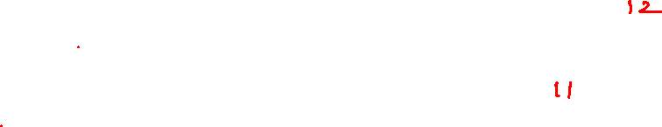
Select different samples of varied sizes
Sample 1
3000 | 2486 | 820 | 1678 | 2070 | 2638 | 2490 | 1865 | 1000 | 2090 | 596 | 3200
Sample 2
2840 | 2858 | 3000 | 2490 | 2998 | 3050 | 2070 | 2896 | 3200 | 2490 | 3280
Sample 3
2858 | 3240 | 2497 | 2865 | 656 | 2093 | 934 | 1861 | 868 | 795
Sample 4
2086 | 1000 | 2497 | 596 | 656 | 875 | 2085 | 934 | 1313
Sample 5
820 | 1313 | 3000 | 2640 | 596 | 2640 | 2600 | 2495 | 934 | 2500

Slide 17
Select different samples of varied sizes
Sample 6
2840 | 2499 | 1327 | 1861 | 2495 | 3024 | 3038 | 2497
Sample 7
2858 | 2490 | 868 | 1670 | 1480 | 2643 | 1480 | 1680 | 2085 | 2490
Sample 8
2495 | 2858 | 1861 | 2092 | 2499 | 3000 | 2660 | 1000 | 1679 | 926 | 2660
Sample 9
795 | 791 | 3200 | 2085 | 2638 | 2497 | 2486 | 1159 | 2640
Sample 10
3019 | 3240 | 3200 | 3050 | 3000 | 3015 | 2900 | 2896 | 2998

Slide 18
Compute sample mean of these samples

Slide 19
Sample No. | Sample size | Mean | SD
1 | 12 | 1994.42 | 843.23
2 | 11 | 2830.18 | 349.94
3 | 10 | 1866.70 | 988.57
4 | 9 | 1338.00 | 704.36
5 | 10 | 1953.80 | 920.44
6 | 8 | 2447.63 | 590.64
7 | 10 | 1974.40 | 638.05
8 | 11 | 2157.27 | 715.10
9 | 9 | 2032.33 | 891.53
10 | 9 | 3035.33 | 117.40
Overall | 100 | 2162.24 | 732.26

Slide 20
Sampling Variability
The term "sampling variability" refers to the fact that the statistical information from a sample (called a statistic) will vary as the random sampling is repeated.
Sampling variability will decrease as the sample size increases.
the samples must be randomly chosen, must be of the same size (not smaller than 30), and the more samples that are used, the more reliable the information gathered will be.
Notes:
A parameter is a fixed number that describes a population, such as a percentage, proportion, mean, or standard deviation. In reality, we do not know these numbers because we cannot examine the entire population.
A statistic is a known number that describes a sample, but it can change from sample to sample.

Slide 21
Notes:
In the inferential statistics process, a researcher selects a random sample from the population,
computes a statistic on the sample, and reaches conclusions about the population
parameter from the statistic. In attempting to analyze the sample statistic, it is
essential to know the distribution of the statistic.

Slide 22
Definition
The probability distribution of a statistic (sample estimate) is called sampling distribution.
The sampling distribution of a statistic depends on the distribution of the population, the size of the sample, and the method of sample selection.

Slide 23
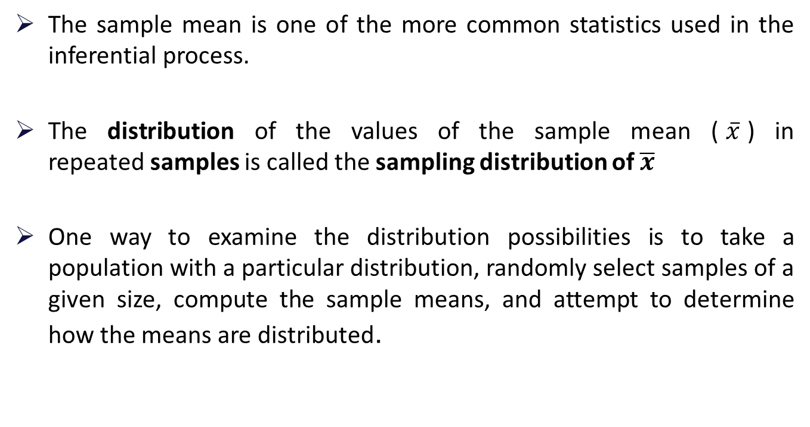
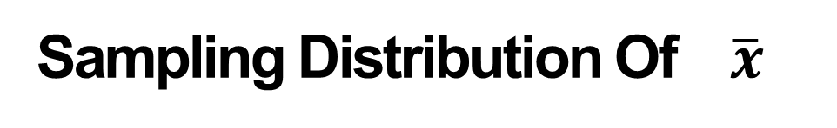
Sampling Distribution Of $\overline{x}$
The sample mean is one of the more common statistics used in the inferential process.
The distribution of the values of the sample mean ($\overline{x}$) in repeated samples is called the sampling distribution of $\overline{x}$
One way to examine the distribution possibilities is to take a population with a particular distribution, randomly select samples of a given size, compute the sample means, and attempt to determine how the means are distributed.
Notes:
To compute and assign the probability of occurrence of a particular value of a sample mean, the researcher must know the distribution of the sample means

Slide 24
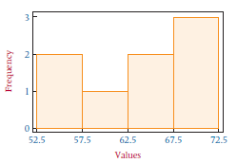
Example
Suppose a small finite population consists of only N = 8 numbers:
54 55 59 63 64 68 69 70
Using an Excel-produced histogram, we can see the shape of the distribution of this population of data.
Suppose we take all possible samples of size n = 2 from this population with replacement.

Slide 25
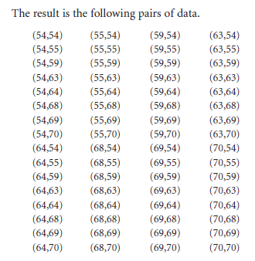
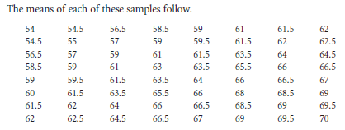
Example

Slide 26
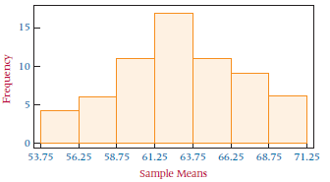
Example
Again using an Excel-produced histogram, we can see the shape of the distribution of these sample means.

Slide 27
Conclusions
Notice that the shape of the histogram for sample means is quite unlike the shape of the histogram for the population.
The sample means appear to “pile up” toward the middle of the distribution and “tail off” toward the extremes.
As sample sizes become much larger, the sample mean distributions begin to approach a normal distribution and the variation among the means decreases.

Slide 28
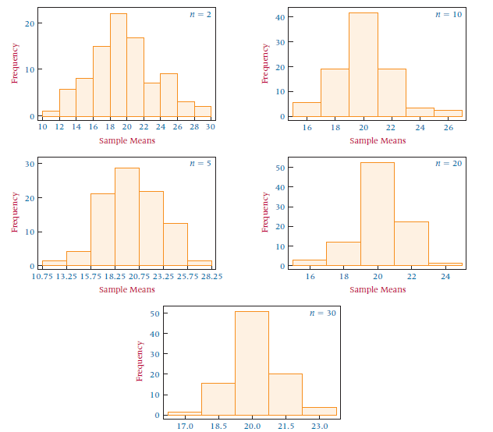
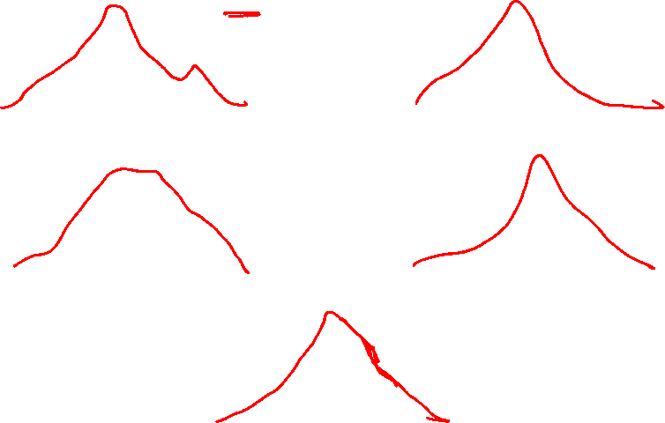
Sample Means from 90 Samples Ranging in Size from n = 2 to n = 30 from a Uniformly Distributed Population with a = 10 and b = 30

Slide 29
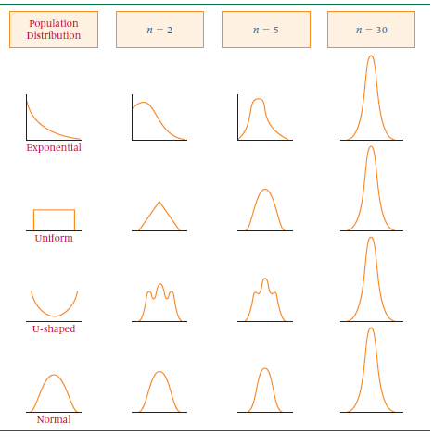
Shapes of the Distributions of
Sample Means
Notes:
This trend makes sense because the standard deviation of the mean is σ/sqrt(n) .
This value will become smaller as the size of n increases.

Slide 30

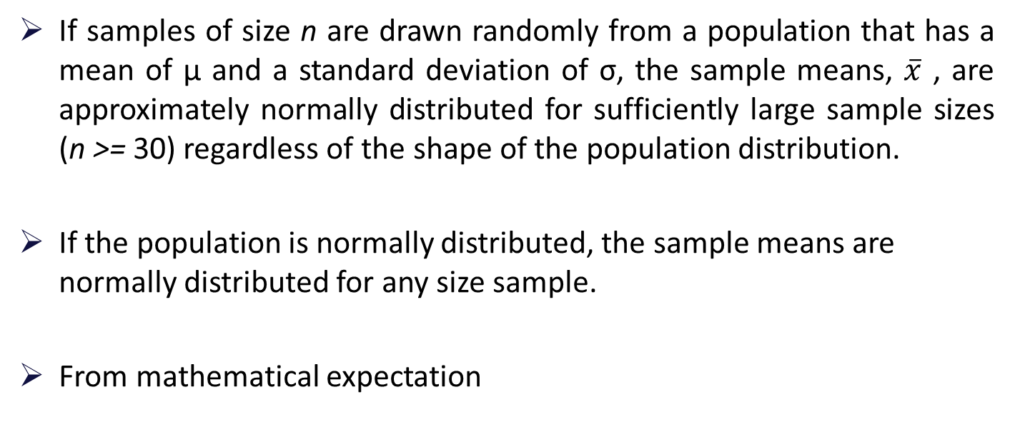
Central Limit Theorem
If samples of size n are drawn randomly from a population that has a mean of µ and a standard deviation of σ, the sample means, $\overline{x}$ , are approximately normally distributed for sufficiently large sample sizes (n >= 30) regardless of the shape of the population distribution.
If the population is normally distributed, the sample means are normally distributed for any size sample.
From mathematical expectation
Notes:
the mean of the sample means is the population mean.
and the standard deviation of the sample means (called the standard error of the mean) is the standard deviation of the population divided by the square root of the sample size.

Slide 31


Z score for sample means
The central limit theorem states that sample means are normally distributed regardless of the shape of the population for large samples and for any sample size with normally distributed populations.
Thus, sample means can be analyzed by using z scores
The formula to determine z scores for individual values from a normal distribution:
If sample means are normally distributed, the z score formula applied to sample means would be
The standard deviation of the statistic of interest is , sometimes referred to as the standard error of the mean.

Slide 32
Example
Suppose the mean expenditure per customer at a tire store is $85.00, with a standard deviation of $9.00.
If a random sample of 40 customers is taken, what is the probability that the sample average expenditure per customer for this sample will be $87.00 or more?

Slide 33
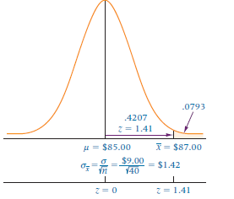

Solution
Because the sample size is greater than 30, the central limit theorem
Can be used, and the sample means are normally distributed.
µ= $85 σ= $9

Slide 35
Example
Suppose that during any hour in a large department store, the average number of shoppers is 448, with a standard deviation of 21 shoppers.
What is the probability that a random sample of 49 different shopping hours will yield a sample mean between 441 and 446 shoppers?

Slide 36



Solution
For this problem, µ= 448, σ= 21, and n = 49. The problem is to determine
P(441<= $\overline{x}$ <=446).
The following

Slide 37


Sampling from a Finite Population
The earlier example was based on the assumption that the population was infinitely or extremely large.
In cases of a finite population, a statistical adjustment can be made to the z formula for sample means. The adjustment is called the finite correction factor
Following is the z formula for sample means when samples are drawn from finite populations.
Notes:
If a random sample of size 35 were taken from a finite population of only 500, the sample
mean would be less likely to deviate from the population mean than would be the case
if a sample of size 35 were taken from an infinite population.

Slide 38
Rules for finite population
As the size of the finite population becomes larger in relation to sample size, the finite correction factor approaches 1.
In theory, whenever researchers are working with a finite population, they can use the finite correction factor.
A rough rule of thumb for many researchers is that, if the sample size is less than 5% of the finite population size or n/N < 0.05, the finite correction factor does not significantly modify the solution.

Slide 39
Example
A production company’s 350 hourly employees average 37.6 years of age, with a standard deviation of 8.3 years.
If a random sample of 45 hourly employees is taken, what is the probability that the sample will have an average age of less than 40 years?

Slide 40

Solution
The population mean is 37.6, with a population standard deviation of 8.3.
The sample size is 45, but it is being drawn from a finite population of 350; that is, n = 45 and N = 350.
The sample mean under consideration is 40
Using the z formula with the finite correction factor gives

Slide 41
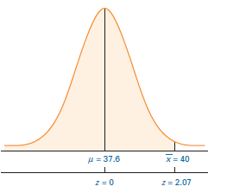


…solution
This z value yields a probability of .4808.
Therefore, the probability of getting a
sample average age of less than
40 years is .4808 + .5000 = .9808.

Slide 42

Sampling Distribution Of Sample Proportion
If research results in countable items such as how many people in a sample have a flexible work schedule, the sample proportion is often the statistic of choice.
Notes:
If research produces measurable data such as weight, distance, time, and income,
the sample mean is often the statistic of choice. However, if research results in countable
items such as how many people in a sample choose Dr. Pepper as their soft drink or how
many people in a sample have a flexible work schedule, the sample proportion is often the
statistic of choice.

Slide 43

Example
In a sample of 100 factory workers, 30 workers might belong to a union.
The value of sample proportion for this characteristic, union membership, is
30/100 = 0 .30

Slide 44

How does a researcher use the sample proportion in analysis?
The central limit theorem applies to sample proportions in that the normal distribution approximates the shape of the distribution of sample proportions
If n*p > 15 and n*q > 15( p is the population proportion and q = 1 - p).
The mean of sample proportions for all samples of size n randomly drawn from a population is p (the population proportion) and the standard deviation of sample proportions is
sometimes referred to as the standard error of the proportion

Slide 45
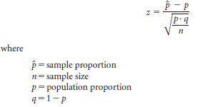
Z Formula For Sample Proportions
For n*p >1 5 and n*q > 15

Slide 46
Example
Suppose 60% of the electrical contractors in a region use a particular brand of wire. What is the probability of taking a random sample of size 120 from these electrical contractors and finding that .50 or less use that brand of wire?

Slide 47
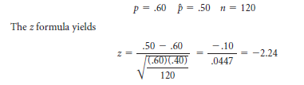
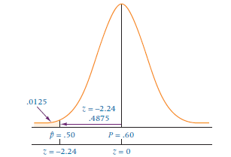

Solution
The probability corresponding to z
= -2.24 is .4875.
For z < -2.24 (the tail of the distribution), the answer is .5000 - .4875 = .0125.

Slide 48
Example
If 10% of a population of parts is defective, what is the probability of randomly selecting 80 parts and finding that 12 or more parts are defective?

Slide 49

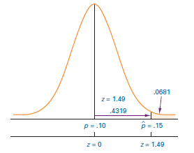
Solution
The probability of .4319 for a z value of 1.49, which is the area between the sample proportion, .15, and the population proportion, .10. The answer to the question is

Slide 50
Forms Of Statistical Inference
Three forms of statistical inference
Point estimation
Interval estimation
Hypothesis testing

Slide 51
Point Estimate
A point estimate is a statistic taken from a sample that is used to estimate a population parameter.
A point estimate is only as good as the representativeness of its sample.
If other random samples are taken from the population, the point estimates derived from those samples are likely to vary.

Slide 52
Interval Estimate
Because of variation in sample statistics, estimating a population parameter with an interval estimate is often preferable to using a point estimate.
An interval estimate (confidence interval) is a range of values within which the analyst can declare, with some confidence, the population parameter lies.

Slide 53
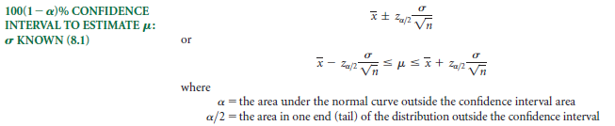
Confidence Interval to Estimate µ
Notes:
It is not certain that the population mean is in the interval unless we have a 100% confidence interval that is infinitely wide.
If we want to construct a 95% confidence interval, the level of confidence is 95%, or .95.

Slide 54
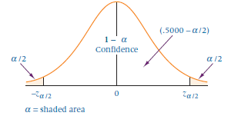
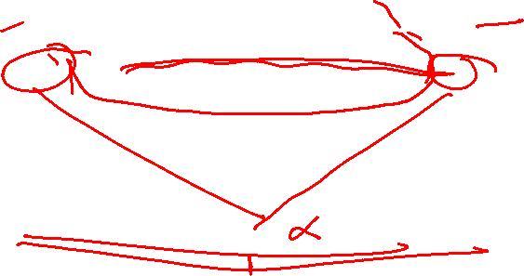
Confidence Intervals

Slide 55
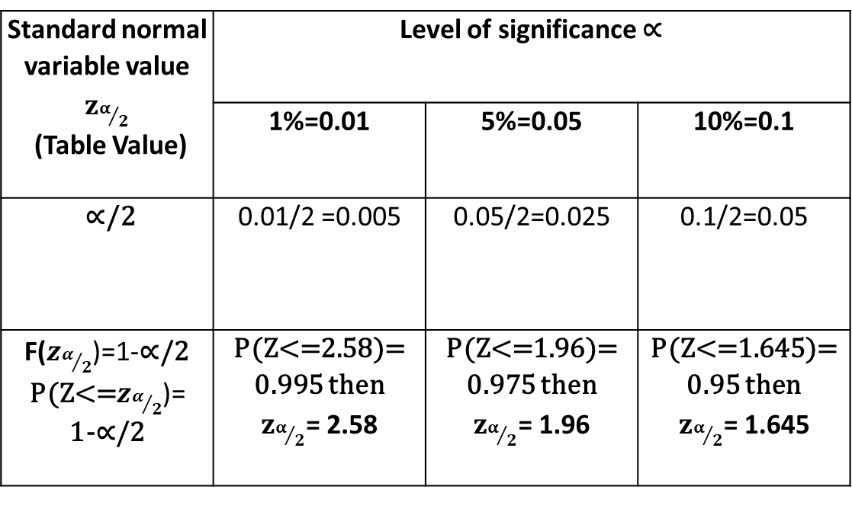
Standard normal variable value $z_{α/2}$ (Table Value) | Level of significance ∝
 | 1%=0.01 | 5%=0.05 | 10%=0.1
∝/2 | 0.01/2 =0.005 | 0.05/2=0.025 | 0.1/2=0.05
F($z_{α/2}$)=1-∝/2 P(Z<=$z_{α/2}$)= 1-∝/2 | P(Z<=2.58)= 0.995 then $z_{α/2}$= 2.58 | P(Z<=1.96)= 0.975 then $z_{α/2}$= 1.96 | P(Z<=1.645)= 0.95 then $z_{α/2}$= 1.645

Slide 56
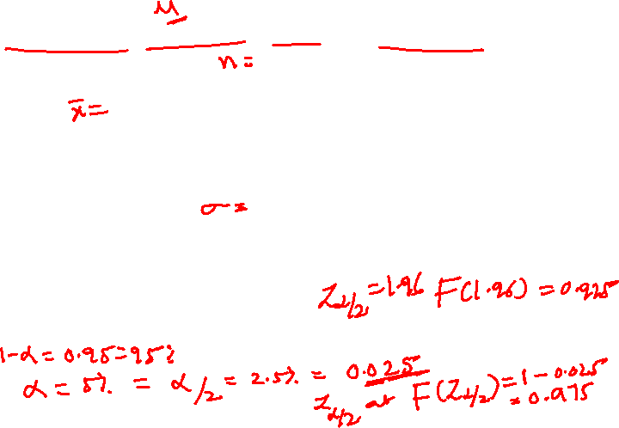
Example
In the cellular telephone company, problem of estimating the population mean number of minutes called per residential user per month, from the sample of 85 bills it was determined that the sample mean is 510 minutes.
Suppose past history and similar studies indicate that the population standard deviation is 46 minutes.
Determine a 95% confidence interval.

Slide 57
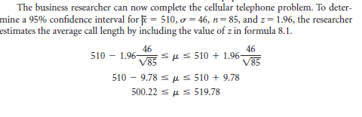
Solution
Notes:
It indicates that, if the company researcher were to randomly select 100 samples
of 85 calls and use the results of each sample to construct a 95% confidence interval,
approximately 95 of the 100 intervals would contain the population mean. It also indicates
that 5% of the intervals would not contain the population mean.

Slide 58
…solution
The confidence interval is constructed from the point estimate, which in this problem is 510 minutes, and the error of this estimate, which is 9.78 minutes.
The resulting confidence interval is 500.22 <= µ <= 519.78.
The cellular telephone company researcher is 95%, confident that the average length of a call for the population is between 500.22 and 519.78 minutes.
Notes:
It indicates that, if the company researcher were to randomly select 100 samples
of 85 calls and use the results of each sample to construct a 95% confidence interval,
approximately 95 of the 100 intervals would contain the population mean. It also indicates
that 5% of the intervals would not contain the population mean.

Slide 59
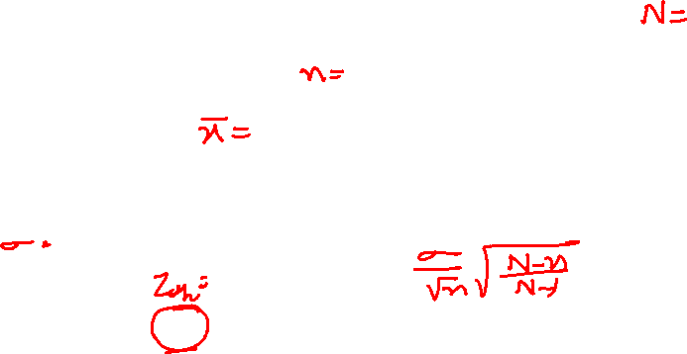
Example
A study is conducted in a company that employs 800 engineers. A random sample of 50 engineers reveals that the average sample age is 34.3 years. Historically, the population standard deviation of the age of the company’s engineers is approximately 8 years.
Construct a 98% confidence interval to estimate the average age of all the engineers in this company.

Slide 60


Solution
This problem has a finite population. The sample size, 50, is greater than 5% of the population, so the finite correction factor may be helpful.
In this case N = 800, n = 50, $\overline{x}$= 34.3 and σ= 8
The z value for a 98% confidence interval is 2.33
Notes:
The finite correction factor takes into account the fact that the population is only
800 instead of being infinitely large. The sample, n = 50, is a greater proportion of the
800 than it would be of a larger population, and thus the width of the confidence
interval is reduced.

Slide 61


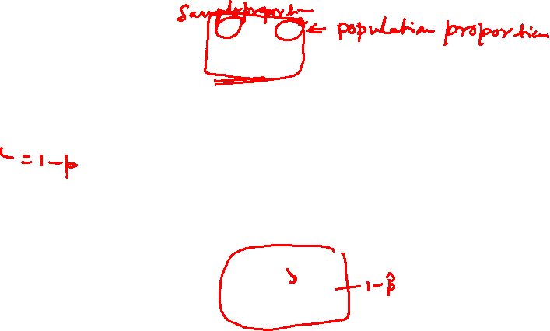
Estimating The Population Proportion
Methods similar to those used earlier can be used to estimate the population proportion.
The central limit theorem for sample proportions led to the following formula
where q = 1 - p. Recall that this formula can be applied only when n*p and n*q are greater than 5.
for confidence interval purposes only and for large sample sizes— is substituted for p in the denominator, yielding
Notes:
When the variable of interest is categorical, the population parameter that we will infer about is the population proportion (p) associated with that variable.
When the variable of interest is quantitative, the population parameter that we infer about is the population mean (μ) associated with that variable.

Slide 62
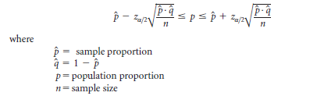

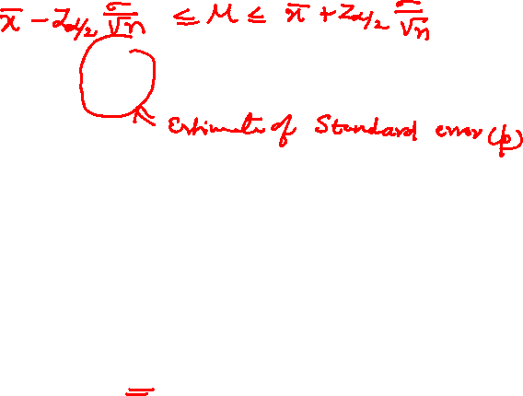
Confidence Interval To Estimate P
Notes:
Because we are not using the true standard deviation of sample proportion, the correct divisor of the standard error of sample proportion is n - 1.
However, for large sample sizes, the effect is negligible. Although technically the minimal sample size for the techniques
presented in this section is n*p and n*q greater than 5, in actual practice sample sizes of several hundred
are more commonly used. As an example, for and of .50 and n = 300, the standard error of is .02887 using
n and .02892 using n - 1, a difference of only .00005.

Slide 63
Example
A study of 87 randomly selected companies with a telemarketing operation revealed that 39% of the sampled companies used telemarketing to assist them in order processing.
Using this information, how could a researcher estimate the population proportion of telemarketing companies that use their telemarketing operation to assist them in order processing?

Slide 64
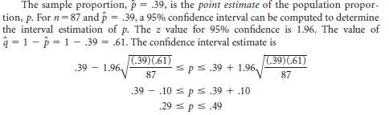

Solution

Slide 65
Example
Coopers & Lybrand surveyed 210 chief executives of fast-growing small companies. Only 51% of these executives had a management succession plan in place. A spokesperson for Cooper & Lybrand said that many companies do not worry about management succession unless it is an immediate problem. However, the unexpected exit of a corporate leader can disrupt and unfocus a company for long enough to cause it to lose its momentum.
Use the data given to compute a 92% confidence interval to estimate the proportions

Slide 66
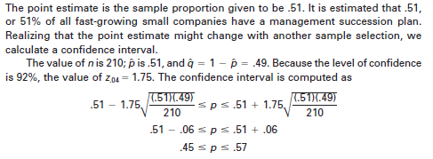
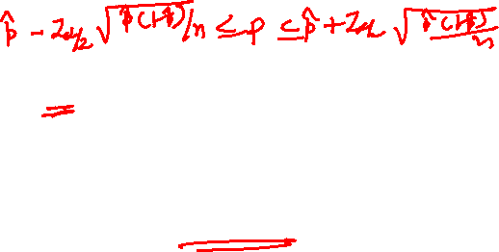
Solution

Slide 67
Home Work Problems
Question :
Car mufflers are constructed by nearly automatic machine. One manufacturer finds that, for any type of car muffler, the time for a person to set up and complete a production run has a normal distribution with mean 1.82 hours and standard deviation 1.20.
What is the probability that the sample mean of the next 40 runs will be from 1.65 to 2.04 hours ?

Slide 68
Question :
Engine bearings depend on a film of oil to keep shaft and bearing surfaces separated. Insufficient lubrication causes bearings to be overloaded. The insufficient lubrication can be modeled as a random variable having a mean 0.6520 ml and standard deviation 0.0125 ml.
The sample mean of insufficient lubrication will be obtained frm a random sample of 60 bearings.
What is the probability that sample mean x will be between 0.600 ml and 0.640 ml ?

Slide 69
Question :
A random sample size of n = 100 is taken from a population with σ = 5.1.
Given that the sample mean is x = 2.16,
construct a 95% confidence interval for the population mean µ.

Slide 70
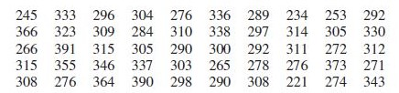
Question :
With reference to the data in section 2.1 (of R1) , we have
n = 50 , x = 305.58 nm, and s2 = 1366.86(hence, s=36.97 nm),
Construct a 99% confidence interval for the population mean of all nanopillars.
*

Slide 71
Exercise
A survey was taken of U.S. companies that do business with firms in India. One of the questions on the survey was: Approximately how many years has your company been trading with firms in India?
A random sample of 44 responses to this question yielded a mean of 10.455 years. Suppose the population standard deviation for this question is 7.7 years.
Using this information, construct a 90% confidence interval for the mean number of years that a company has been trading in India for the population of U.S. companies trading with firms in India.

Slide 72
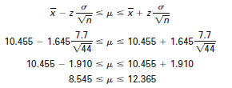

Solution
Here, n= 44, $\overline{x}$= 10.455 and σ= 7.7. To determine the value of z_{α/2}, divide the
90% confidence in half, or take .5000 - α/2= .5000 - .0500= 0.45 where α= 10%.
Z table yields a z value of 1.645 for the area of .45
The confidence interval is

Slide 73
Exercise
A clothing company produces men’s jeans. The jeans are made and sold with either a regular cut or a boot cut. In an effort to estimate the proportion of their men’s jeans market in Oklahoma City that prefers boot-cut jeans, the analyst takes a random sample of 212 jeans sales from the company’s two Oklahoma City retail outlets. Only 34 of the sales were for boot-cut jeans.
Construct a 90% confidence interval to estimate the proportion of the population in Oklahoma City who prefer boot-cut jeans.

Slide 74
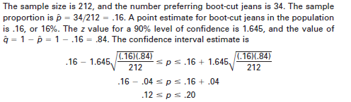
Solution

Slide 75
Thank You

